Slide 1
UE18CS390A – Capstone Project Phase – 1
Project Progress Review #3
Project Title : Visual Question Answering on Statistical Plots
Project ID : PW22MHR02
Project Guide : Dr. Mamatha H.R.
Project Team : Sneha Jayaraman PES1201802825
Sooryanath I T PES1201802827
Himanshu Jain PES1201802828

Slide 2
Abstract and Scope
The aim of the project is to build a Visual Question Answering system which accepts statistical plots along with questions on the plot with respect to the elements of the plot (such as intersection of the curves, area under the curve, median value and few other varieties of such relational queries) and provides answers to the questions posed.
The most important benefit is that visual question answering models on charts will help data analysts question and reason plots on a large scale, and automate the decision-making capabilities in several sectors such as the financial sector
Notes:
Well defined problem statement.
Provide a basic introduction of the project and also an overview of scope it entails.

Slide 3
Suggestions from Review - 1,2
Data for the model
Type of charts we will be addressing
Bar Charts, Pie Charts and Line Charts
Real-Time Data for testing sources
Open ended questions or yes/no questions
Domain of the project
Financial Domain, Educational Domain
Domain is unrestricted and depends on the type of charts selected
Notes:
Provide the suggestions and remarks given by the panel members.
Mention the feasibility on the same showing the progress.

Slide 4
Design Approach
Object Detection in Images:
The difficulty with statistical plots is that even though they are images, they contain both structured and unstructured data. In the case of natural images, there are just visual elements to handle. However, that is not the case with statistical plots, since they contain both visual elements in the form of bars/sectors and textual elements in the form of axis labels and ticks. To add to this, the size of objects that are there in natural images are constrained to small, medium and large in general. In the case of statistical plots, the aspect ratio is much more varied. For example, in the case of bar plots, there could be bars that are extremely small, and bars that are extremely large on the same plot.
Notes:
What is the design approach followed? And Why?
Benefits of this approach & are there any drawbacks?
Alternate design approaches, if any.

Slide 5
Design Approach
The measure of the accuracy of prediction in the case of images is normally IOU ( intersection over union ). The success criteria for a correct prediction in the case of natural images is normally 50 per cent. The same rate is insufficient for statistical plots. This is because we want the prediction for a bar value (in the case of bar plots) to correspond to the actual value as seen on the graph, as close as possible. Therefore the adequacy criteria for a successful prediction is much higher.
The above-mentioned factors highlight the differences in natural images and statistical plots. Therefore, state-of-the-art object detection models do not suffice for this application.
Notes:
What is the design approach followed? And Why?
Benefits of this approach & are there any drawbacks?
Alternate design approaches, if any.

Slide 6
Design Approach
Existing Deep Learning Models and our current idea:
The baseline models as used by multiple papers is the RN model (Relation Networks). Papers have been published that propose CNN + LSTM pipeline models to tackle this problem. Additionally, one recent paper mentioned the use of OCR and semi-structured information extraction to tabulate data obtained from the plots.
We intend to combine these approaches, to obtain a better overall accuracy across a variety of plot types. Additionally, we would want to explore on other variants of memory cells than the ones experimented with , that can better capture information.
A potential case would be to investigate the non usage of gated recurrent units over LSTM cells and non usage of R-CNNs over the traditional CNNs.
Notes:
What is the design approach followed? And Why?
Benefits of this approach & are there any drawbacks?
Alternate design approaches, if any.

Slide 7
Design Constraints, Assumptions & Dependencies
The design approach chosen is constrained by the existing OCR and VED(visual edge detection) module implementations which are serving as shelf components and their usage can be attributed to component based software engineering/implementation. Additionally, it makes use of annotated graph plots with question-answer pairs for a variety of plots.
It is constrained by the tensorflow GPU’s for model training.
Notes:
Discuss the design constraints and assumptions that you have made to select the design approach.
Discuss any dependencies that your design approach has and their impact on the project.

Slide 8
Limitations/ Constraints / Risks
Limitations:
The system will not be able to answer questions on the smoothness or the roughness of the plots. It can only answer relational queries – queries with respect to the other elements of the plot.
Constraints:
The project focuses on model building and providing for accurate and reliable answers to the questions posed on the statistical charts. Hence, there is less focus on the security and interoperability considerations. However, our solution will consist of an interface to the model that facilitates image upload and questions on the image.
Risks:
Operational risk in terms of management and support for the product is a possible risk case.
Notes:
Discuss the design constraints and assumptions that you have made to select the design approach.
Discuss any dependencies that your design approach has and their impact on the project.

Slide 9
Proposed Methodology / Approach
Encoder Decoder Architecture:
CNN - To be used for obtaining an image representation
LSTM/ variants such as GRU’s - To be used for obtaining representation for the question
OCR - VED - Information Extraction Module - Additional module for extracting and tabulating data values.
Table creation based on the OCR and VED results so that the input queries can be treated as relational queries.
Apart from this we would like to explore on R-CNN’s and other variants for better overall accuracy for the various plots.
Ideally we would like to develop one model that works for all chosen plots under our workframe. However, we are open for further exploration in terms of fine tuning our model.
Notes:
Details of the new approach- benefits/drawbacks

Slide 10
Architecture
High Level Design:
Question Answering System for Charts take in statistical charts and questions related to them as input. Visual features from the charts have to be extracted and preprocessed. This can be done using techniques like image processing and Optical Character Recognition (OCR). The questions provided as an input need to be pre-processed using deep learning/NLP techniques. Important details from the image and the questions need to be mapped and the corresponding answer should be predicted. Deep learning methods and architectures will be employed to predict the output.
Inputs are validated by the system to recognize only statistical charts. Any other images will be rejected by the system. The system will be trained on huge amounts of data and the results will be validated against the true answers. The parameters for the model will be tuned to provide the most optimal answer as the output.
Notes:
Provide high-level design view of the system.
Identify the logical user groups, application components, data components, and interfacing systems. Illustrate the collaboration and interaction between the major components.

Slide 11
Architecture
Input: There are two inputs to our model that the user needs to provide. The first input is an image – that depicts a statistical plot and the second input is a relational question on the image.
Our Model:
The design consists of 3 primary components.
1. Image Encoding Module
This is a module that takes in the image as its input and produces image feature vectors as its output. Feature vectors are a vector representation of the image that encodes all of the relevant information in the image.
Notes:
Provide high-level design view of the system.
Identify the logical user groups, application components, data components, and interfacing systems. Illustrate the collaboration and interaction between the major components.

Slide 12
Architecture
2. Question Encoding Module
The input to this module is the question (English Language) and the output is a question embedding. The question embedding captures all of the relevant information in the question in a format that is suitable for further modelling.
3. Result Estimation Module
This module takes in as input the output produced by both of the previous modules. It produces as an output the final answer to the question. Thereby, it finds the correlation between the image and the question based on previous training on a variety of image-question pairs.
Output: The output is an answer to the question that was posed on the image.
Notes:
Provide high-level design view of the system.
Identify the logical user groups, application components, data components, and interfacing systems. Illustrate the collaboration and interaction between the major components.

Slide 13
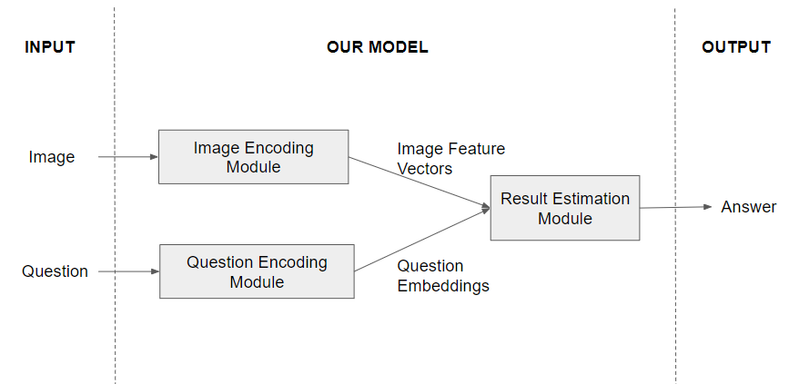
Design Description
HIGH LEVEL DESIGN
Notes:
Add as many slides as required to cover the following aspects:
Master class diagram
ER Diagram
User Interface Diagrams/ Use Case Diagrams
Report Layouts
External Interfaces

Slide 14
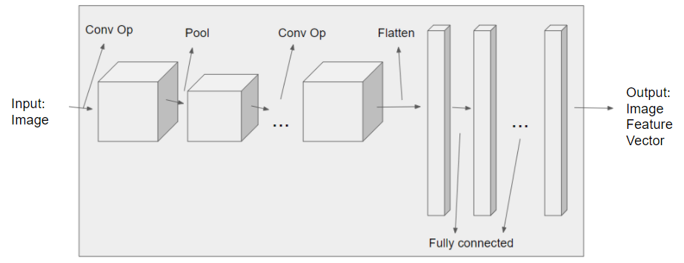
Design Description - Individual Components
Image Encoding Module:
This consists of a sequence of convolution operations and pooling operations, followed by fully connected layers that would output a flattened image feature vector.
Notes:
Add as many slides as required to cover the following aspects:
Master class diagram
ER Diagram
User Interface Diagrams/ Use Case Diagrams
Report Layouts
External Interfaces

Slide 15
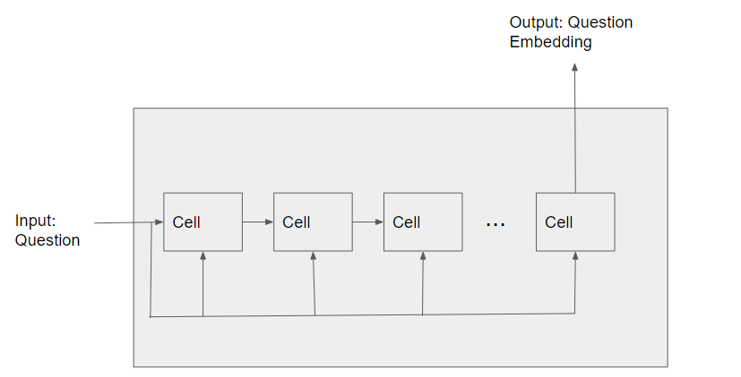
Design Description - Individual Components
Question Encoding Module:
This consists of a series of recurrent cells, that would take each word of the input question as its input, to finally output a question embedding.
Notes:
Add as many slides as required to cover the following aspects:
Master class diagram
ER Diagram
User Interface Diagrams/ Use Case Diagrams
Report Layouts
External Interfaces

Slide 16
Project Progress
Problem statement is well-defined and thorough exploration is conducted in the associated domain.
Thorough Literature survey pertaining to multiple variants of the problem is done to explore the innovation that can be brought to the project.
Data to be used for the project
Notes:
What is the project progress so far?
What is the percentage completion of the project?

Slide 17
Existing Solutions
Answering Questions about Charts and Generating Visual Explanations
https://github.com/dhkim16/VisQA-release
FigureNet: A Deep Learning model for Question-Answering on Scientific Plots
https://github.com/vmichals/FigureQA-baseline
https://github.com/Maluuba/FigureQA
https://github.com/Maluuba/FigureQA/releases/tag/v0.1.0
PlotQA: Reasoning over Scientific Plots
https://github.com/NiteshMethani/PlotQA
DVQA: Understanding Data Visualizations via Question Answering
https://github.com/kushalkafle/DVQA_dataset
https://github.com/xeniaqian94/DVQA

Slide 18
References
Kim, Dae Hyun, Enamul Hoque, and Maneesh Agrawala. "Answering questions about charts and generating visual explanations." Proceedings of the 2020 CHI Conference on Human Factors in Computing Systems. 2020.
Reddy, Revanth, et al. "Figurenet: A deep learning model for question-answering on scientific plots." 2019 International Joint Conference on Neural Networks (IJCNN). IEEE, 2019.
Sharma, Monika, et al. "ChartNet: Visual reasoning over statistical charts using MAC-Networks." 2019 International Joint Conference on Neural Networks (IJCNN). IEEE, 2019.
Methani, Nitesh, et al. "Plotqa: Reasoning over scientific plots." Proceedings of the IEEE/CVF Winter Conference on Applications of Computer Vision. 2020.
Notes:
Provide references pertaining to your research according to IEEE format.
Example:
G. Eason, B. Noble, and I. N. Sneddon, “On certain integrals of Lipschitz-Hankel type involving products of Bessel functions,” Phil. Trans. Roy. Soc. London, vol. A247, pp. 529–551, April 1955. (references)

Slide 19
Thank You

